Slide 1
Final Presentation
Natural Language Processing
Rebecka Fahrni, Joseph Weibel

Slide 2
Agenda
Recap Project Goal
Dataset Overview
Evaluation Metric of Models
Baseline Models
Applying BERT-like and GPT-like models

Slide 3

Recap Project’s Goal
Classification of medical transcriptions into medical specialties

Slide 4
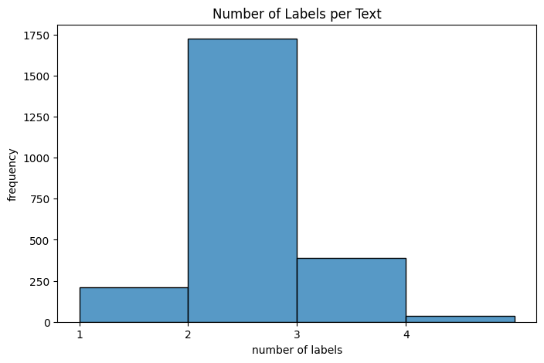
Dataset Overview
Medical transcriptions for various medical specialties
Highly unbalanced dataset
Different text styles: very long text and shorter ones
Letters vs. Autopsy reports
Multi-Label - most text have at least 2 labels
Some classes have only very few samples

Slide 5

Evaluation Strategy
Evaluation of method: 3-fold cross-validation to ensure robust model assessment.
Comparing advanced models to simpler machine learning models to evaluate improvements.
Accuracy does not provide a complete picture of model performance, especially where class imbalance in the dataset.
Primary Metric: F1-scores, balancing precision and recall for a holistic performance view
Harmonic mean of precision and recall
F1-score crucial for datasets with imbalanced classes.
High F1 score: well-balanced performance
Low F1 score: model trouble striking balance

Slide 6
Baseline Models
Pipeline:
TF-IDF
Pre-processing:
standarize text length (512 tokens)
Lowercasing
Stemming (Snowball) / (Lemmatization – did not apply)
Punctuations, numbers removal
Label preprocessing: filtering out labels with fewer than 20 texts to focus on more significant labels
Balancing dataset (model specific, can‘t be done for every model in a multilabel setting)
Tested: SVM, NB, RF, XGBoost,

Slide 7
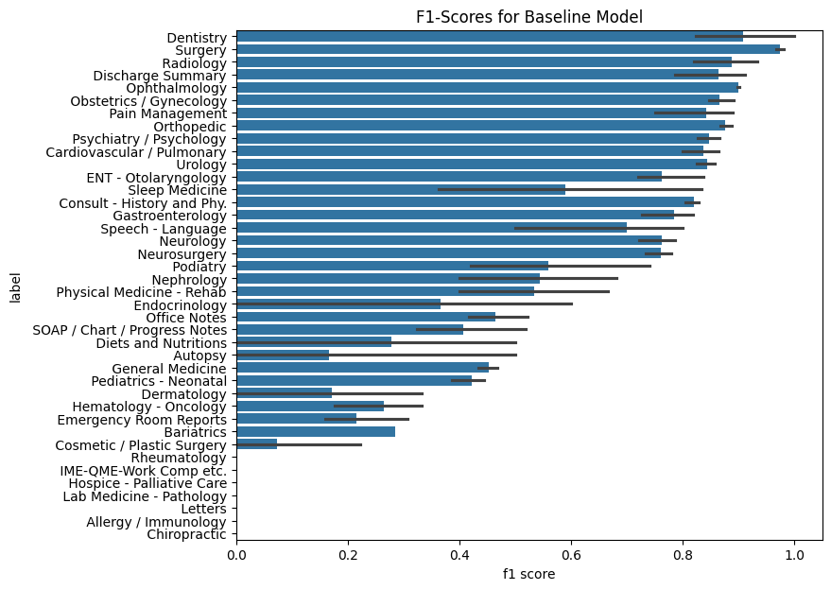
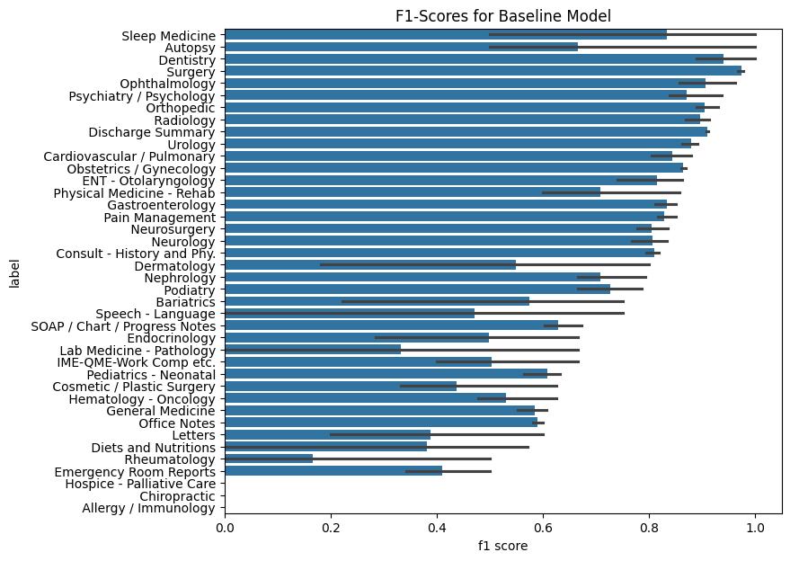
F1-Scores for Baseline Model - sVM
SVM – unbalanced class weights
SVM – balanced class weights

Slide 8
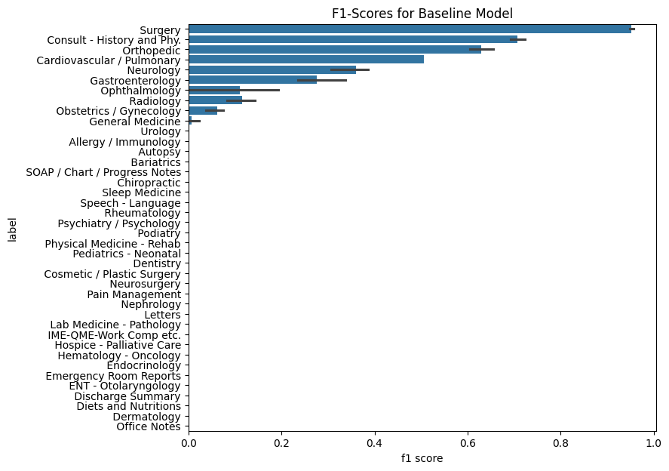
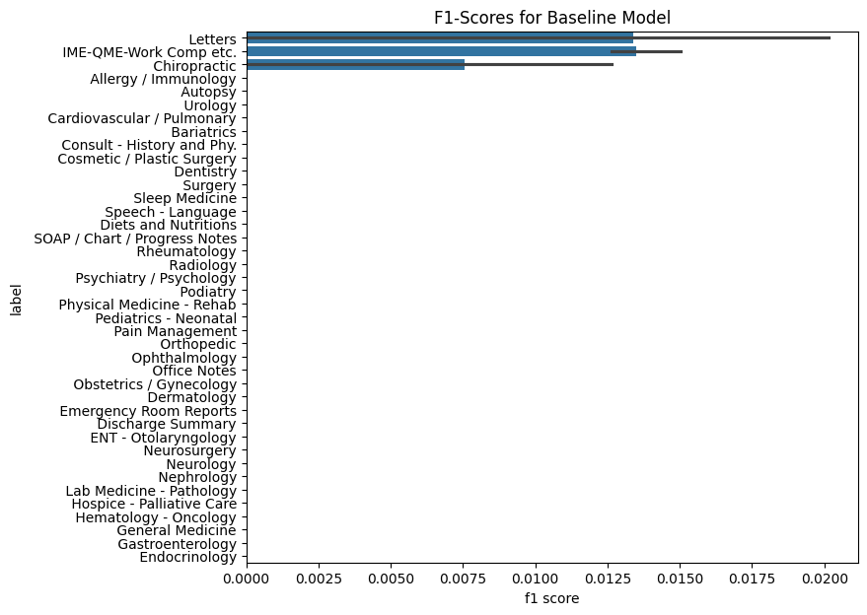
F1-Scores for Baseline Model - Naive Bayes
NB - unbalanced class weights
NB - balanced class weights
Other models can handle imbalanced data better. Random Forests or Gradient Boosting Machines can be more resilient to class imbalance.

Slide 9
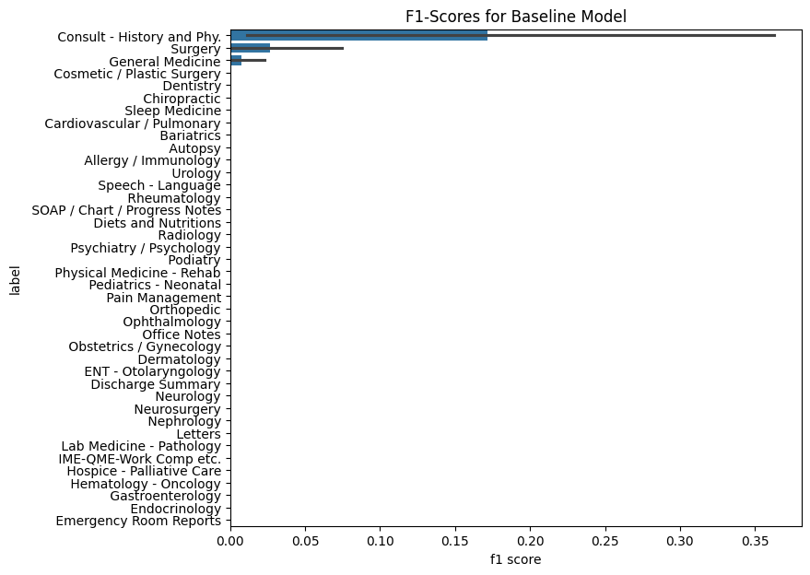
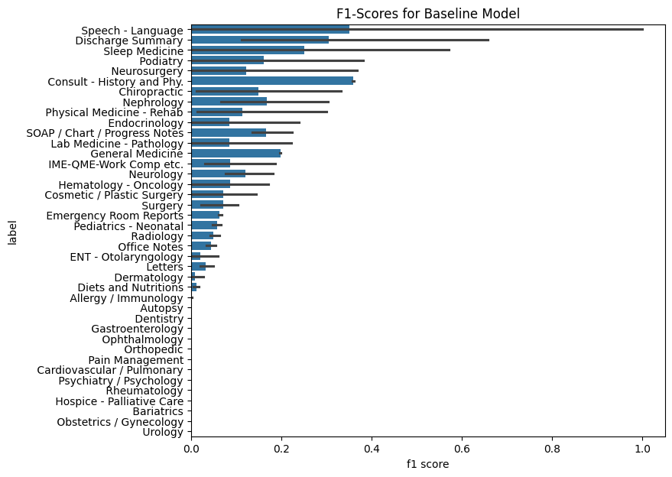
F1-Scores for Baseline Model – Random Forest
RF- unbalanced class weights
RF - balanced class weights

Slide 10
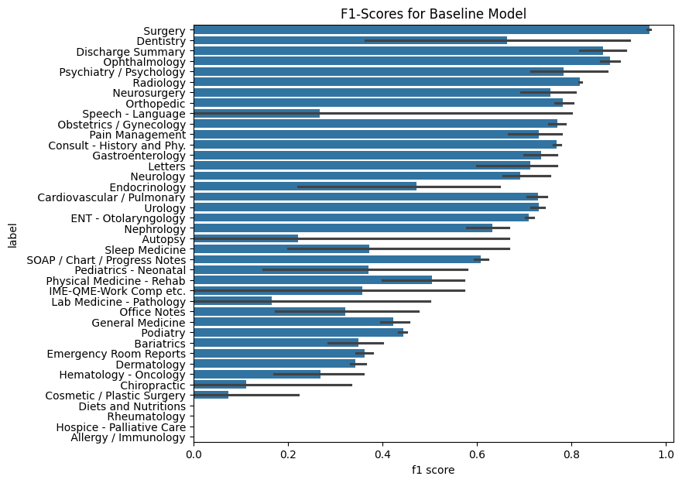
F1-Scores for Baseline Model – XGBoost
XGBoost - unbalanced class

Slide 11
Baseline model
Variability in F1 Scores: Variance in F1 scores across different medical categories some labels easier to predict than others, or that the models are better suited for some categories.
Impact of Class Balance:
Random Forest: balance class weights in Random Forest models has led to a more uniform distribution of F1 scores across categories – positive impact of handling class imbalance for model performance
SVM: Balanced class weights improved performance on several minority classes
NB and XGBoost: These models do not inherently support class weights and show more disparity in performance across categories. NB struggles more with the class imbalance, gradient boost is more robust.
Suggest using XGBoost or SVM as a baseline do better in the setting of unbalanced mulitlabel classification task.

Slide 12
ADVANCED Models
BERT
Advanced Models: Exploring the capabilities of BERT and GPT in medical text analysis used for identifying complex language patterns
No preporcessing for BERT
Reducing token length to 256
BERT Variants: Utilizing bert-base-uncased and biobert for nuanced text understanding.

Slide 13
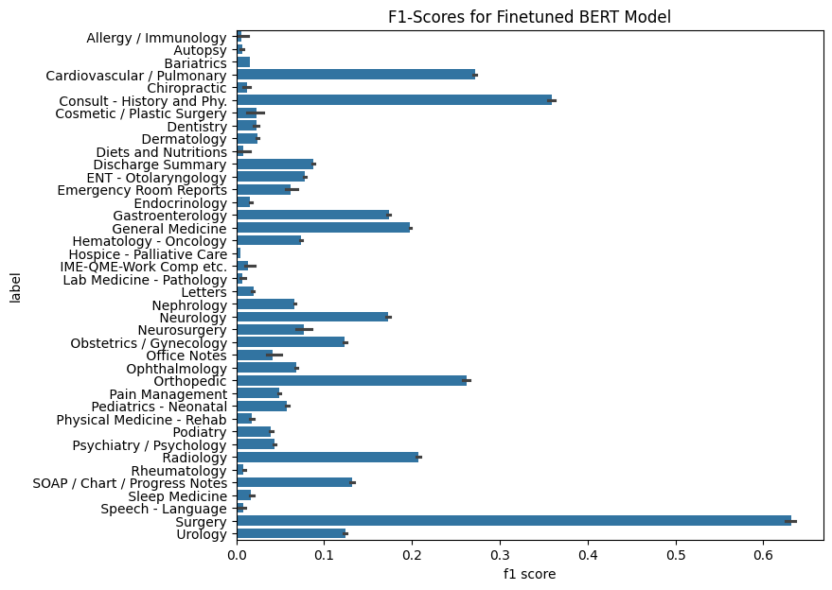
Advanced Models
finetuned bert-base-uncased
classes with more samples perform better
not enough data to train linear layer
uncertainty between folds is low

Slide 14
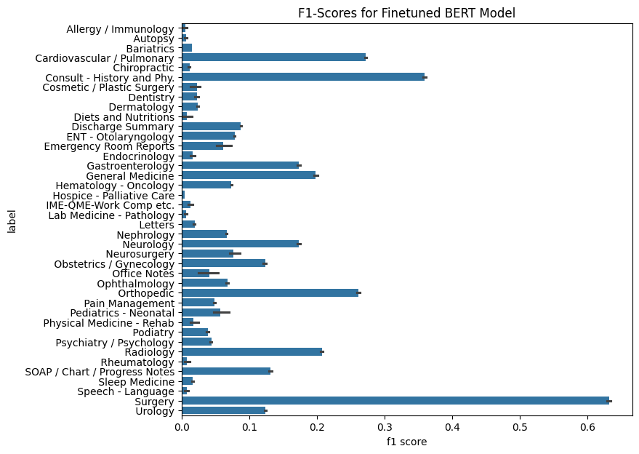
Advanced Models
finetuned dmis-lab/biobert-base-cased-v1.2
very similar results

Slide 15
BERT modelS
Improving Model Quality
Reduce class imbalance either by weighted loss or upsampling
Increase number of training epoch
Use 5-fold cross validation to increase training set size

Slide 16
ADVANCED Models
GPT
GPT Models: Implementing llama2 and meditron for comprehensive label prediction.
Llama2 can be used for pre-annotations – automated data labeling
Experiment with MEDITRON
Testing different prompts:
Zero-Shot
Few-Shot
Chain-of-Thought

Slide 17
Thank you
Rebecka Fahrni, Joseph Weibel

